Slide 1
Bayesian Decision Theory
(Classification)
主講人：虞台文

Slide 2
Contents
Introduction
Generalize Bayesian Decision Rule
Discriminant Functions
The Normal Distribution
Discriminant Functions for the Normal Populations.
Minimax Criterion
Neyman-Pearson Criterion

Slide 3
Bayesian Decision Theory
(Classification)
Introduction

Slide 4
What is Bayesian Decision Theory?
Mathematical foundation for decision making.
Using probabilistic approach to help making decision (e.g., classification) so as to minimize the risk (cost).

Slide 5
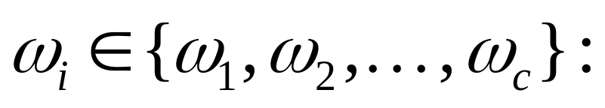
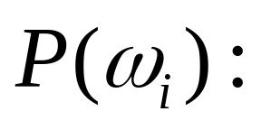

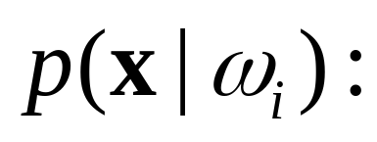
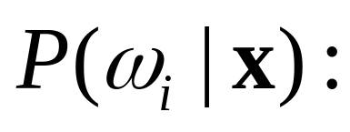
Preliminaries and Notations
a state of nature
prior probability
feature vector
class-conditional
density
posterior probability

Slide 6
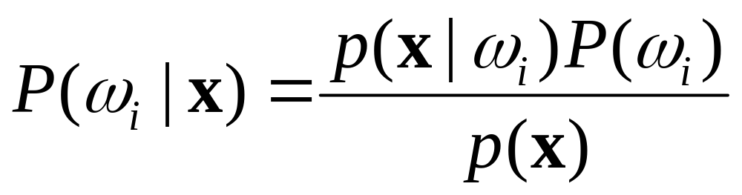
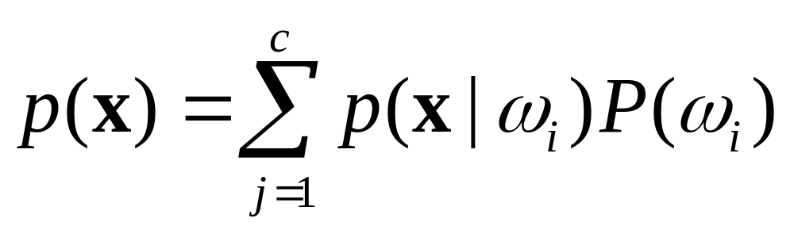
Bayesian Rule

Slide 7
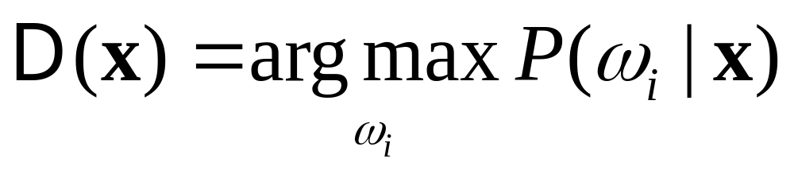
Decision
unimportant in
making decision

Slide 8

Decision
Decide ω_{i} if P(ω_{i}|x) > P(ω_{j}|x) ∀ j ≠ i
Decide ω_{i} if p(x|ω_{i})P(ω_{i}) > p(x|ω_{j})P(ω_{j}) ∀ j ≠ i
Special cases:
P(ω₁)=P(ω₂)= ⋅ ⋅ ⋅=P(ω_{c})
p(x|ω₁)=p(x|ω₂) = ⋅ ⋅ ⋅= p(x|ω_{c})

Slide 9
Decide ω_{i} if P(ω_{i}|x) > P(ω_{j}|x) ∀ j ≠ i
Decide ω_{i} if p(x|ω_{i})P(ω_{i}) > p(x|ω_{j})P(ω_{j}) ∀ j ≠ i
Two Categories
Decide ω₁ if P(ω₁|x) > P(ω₂|x); otherwise decide ω₂
Decide ω₁ if p(x|ω₁)P(ω₁) > p(x|ω₂)P(ω₂); otherwise decide ω₂
Special cases:
P(ω₁)=P(ω₂)
Decide ω₁ if p(x|ω₁) > p(x|ω₂); otherwise decide ω₁
2. p(x|ω₁)=p(x|ω₂)
Decide ω₁ if P(ω₁) > P(ω₂); otherwise decide ω₂

Slide 10
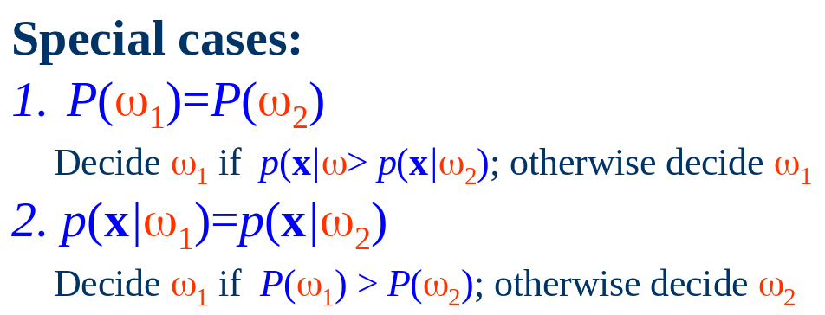
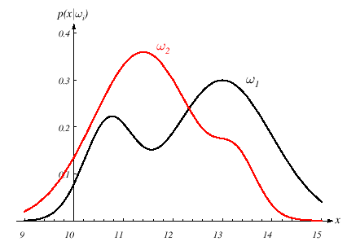
Example
R₂
R₁
P(ω₁)=P(ω₂)

Slide 11
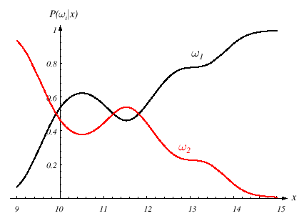
Example
P(ω₁)=2/3
P(ω₂)=1/3
R₂
R₁
R₂
R₁
Decide ω₁ if p(x|ω₁)P(ω₁) > p(x|ω₂)P(ω₂); otherwise decide ω₂

Slide 12
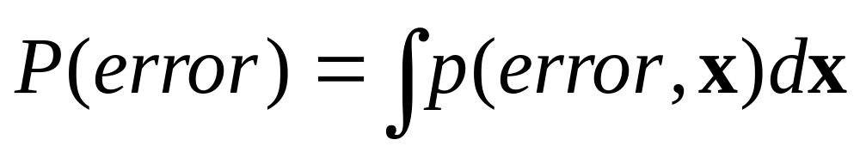
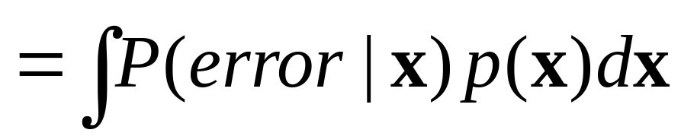
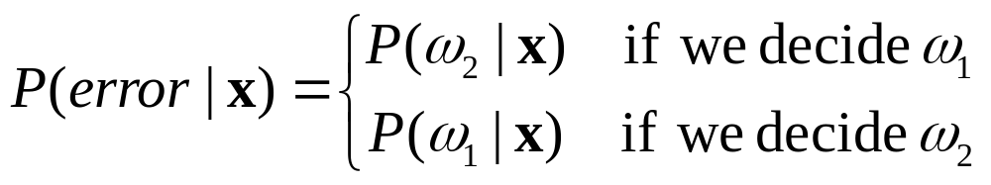

Classification Error
Consider two categories:
Decide ω₁ if P(ω₁|x) > P(ω₂|x); otherwise decide ω₂

Slide 13
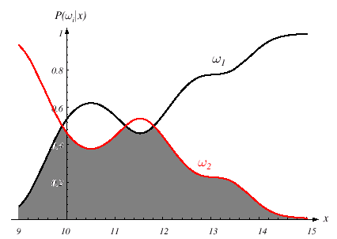
Classification Error
Consider two categories:
Decide ω₁ if P(ω₁|x) > P(ω₂|x); otherwise decide ω₂

Slide 14
Bayesian Decision Theory
(Classification)
Generalized Bayesian Decision Rule

Slide 15
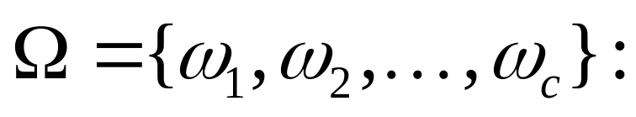
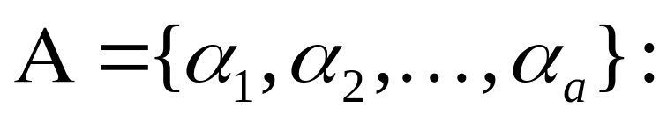
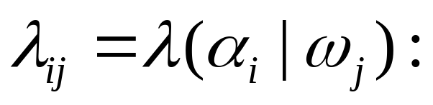
The Generation
a set of c states of nature
a set of a possible actions
The loss incurred for taking action α_{i} when the true state of nature is ω_{j}.
can be zero.
Risk
We want to minimize the expected loss in making decision.

Slide 16
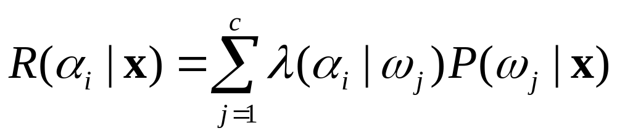
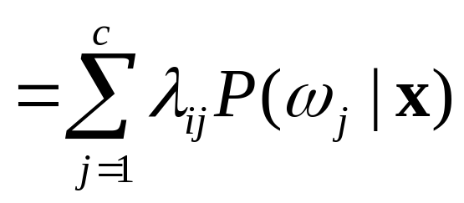
Conditional Risk
Given x, the expected loss (risk) associated with taking action
α_{i}.

Slide 17
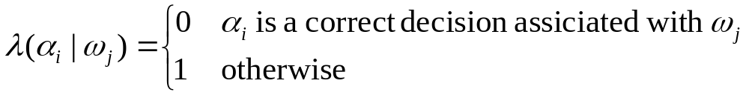
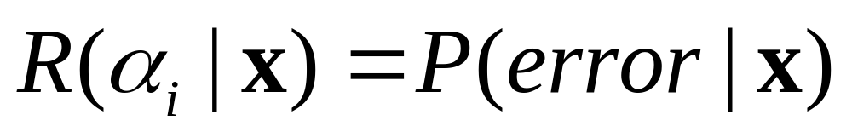
0/1 Loss Function

Slide 18
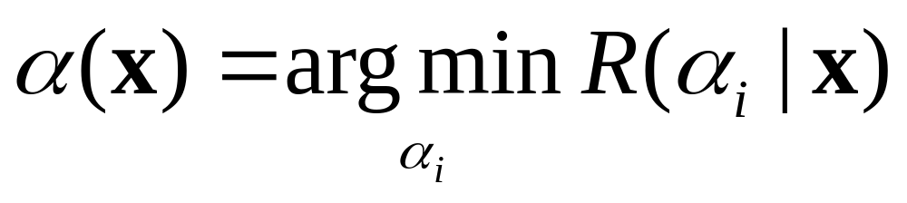
Decision
Bayesian Decision Rule:

Slide 19
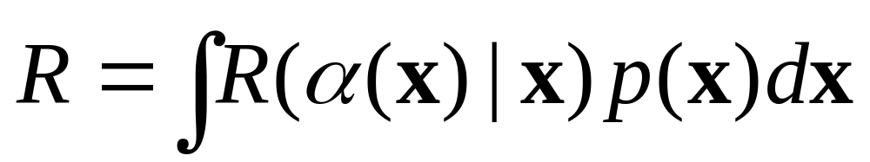
Overall Risk
Decision function
Bayesian decision rule:
  the optimal one to minimize the overall risk
  Its resulting overall risk is called the Bayesian risk

Slide 20
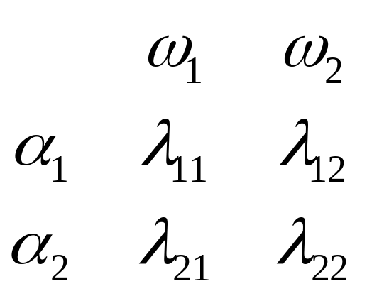
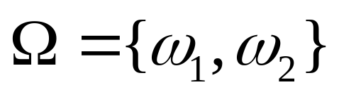
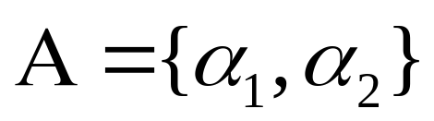
Two-Category Classification
State of Nature
Loss Function
Action

Slide 21
Two-Category Classification
Perform α₁ if R(α₂|x) > R(α₁|x); otherwise perform α₂

Slide 22
Two-Category Classification
Perform α₁ if R(α₂|x) > R(α₁|x); otherwise perform α₂
positive
positive
Posterior probabilities are scaled before comparison.

Slide 23
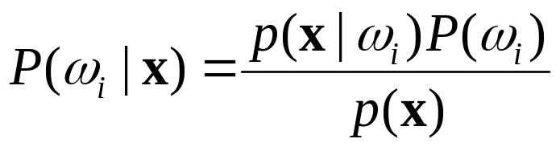
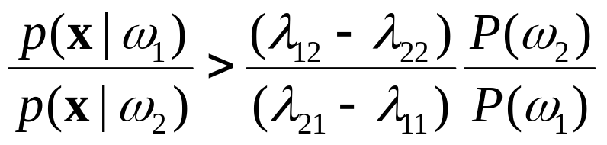
irrelevant
Two-Category Classification
Perform α₁ if R(α₂|x) > R(α₁|x); otherwise perform α₂

Slide 24
This slide will be recalled later.
Two-Category Classification
Threshold
Likelihood
Ratio
Perform α₁ if

Slide 25
Bayesian Decision Theory
(Classification)
Discriminant Functions

Slide 26
How to define discriminant functions?
The Multicategory Classification
g_{i}(x)’s are called the discriminant functions.
g₁(x)
Action
(e.g., classification)
α(x)
x
g₂(x)
g_{c}(x)
Assign x to ω_{i} if
g_{i}(x) > g_{j}(x) for all j ≠ i.

Slide 27
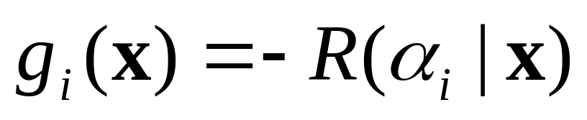
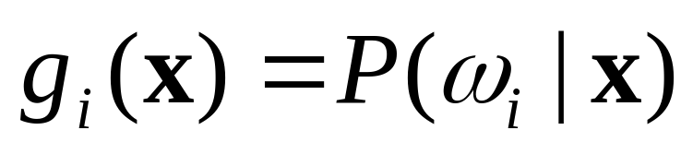
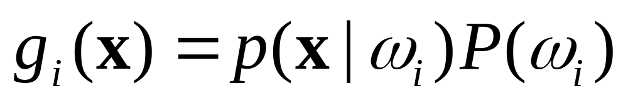
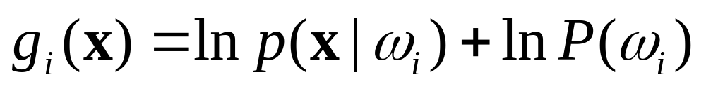
If f(．) is a monotonically increasing function, than f(g_{i}(．) )’s are also be discriminant functions.
Simple Discriminant Functions
Minimum Risk case:
Minimum Error-Rate case:

Slide 28
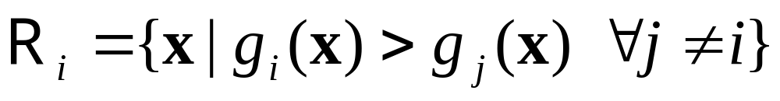
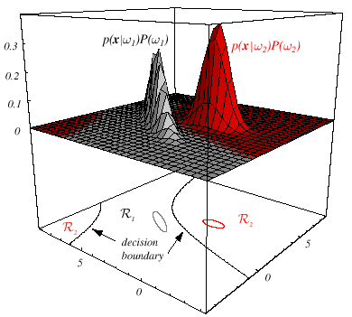
Decision Regions
Two-category example
Decision regions are separated by decision boundaries.

Slide 29
Bayesian Decision Theory
(Classification)
The Normal Distribution

Slide 30

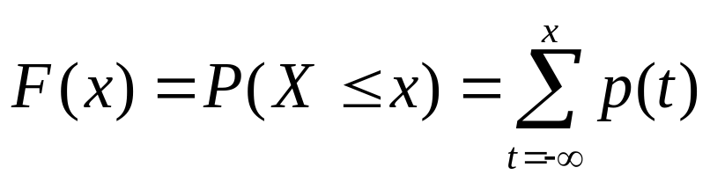

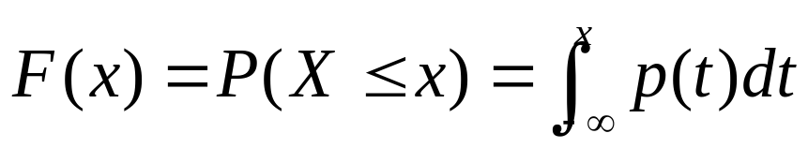
Basics of Probability
Discrete random variable (X) － Assume integer
Probability mass function (pmf):
Cumulative distribution function (cdf):
Continuous random variable (X)
Probability density function (pdf):
not a probability
Cumulative distribution function (cdf):

Slide 31
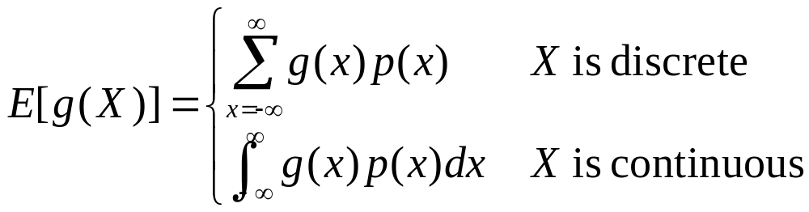
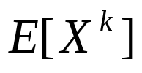

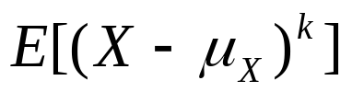
Expectations
Let g be a function of random variable X.
The k^{th} moment
The 1st moment
The k^{th} central moments

Slide 32
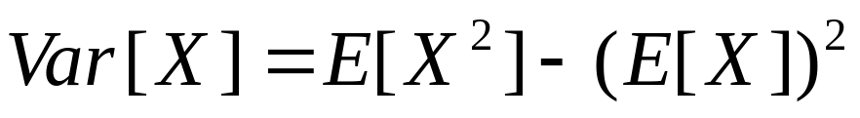
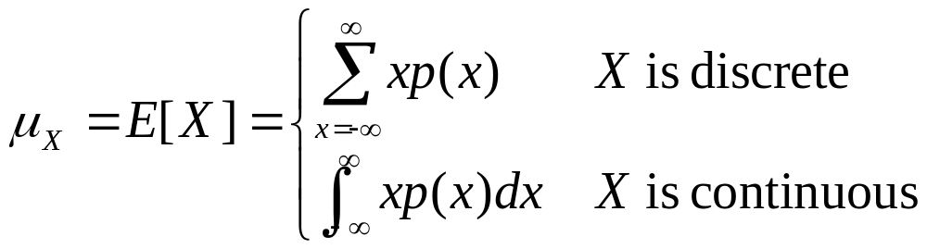
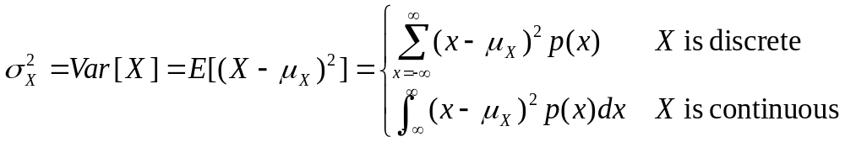
Fact:
Important Expectations
Mean
Variance

Slide 33
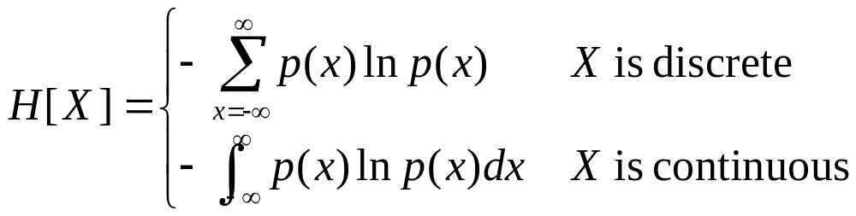
Entropy
The entropy measures the fundamental uncertainty in the value of points selected randomly from a distribution.

Slide 34
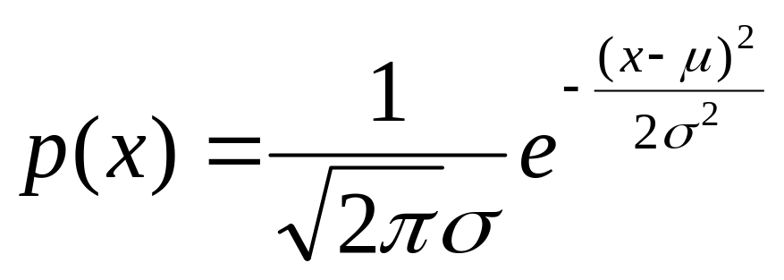
Properties:
Maximize the entropy
Central limit theorem
Univariate Gaussian Distribution
X~N(μ,σ²)
p(x)
μ
x
σ
σ
E[X] =μ
2σ
2σ
3σ
3σ
Var[X] =σ²

Slide 35
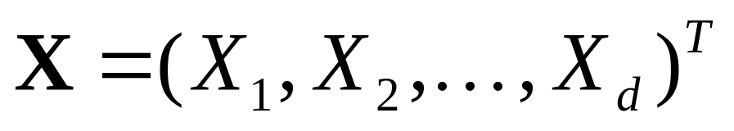
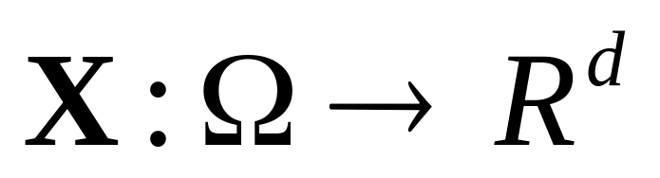
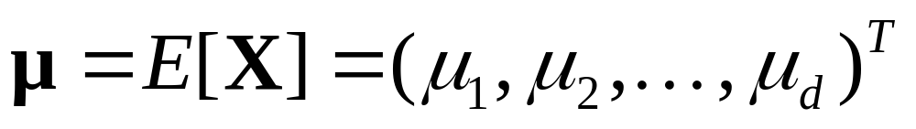
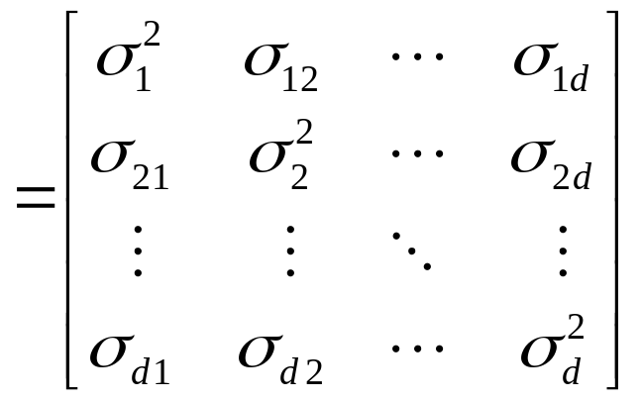
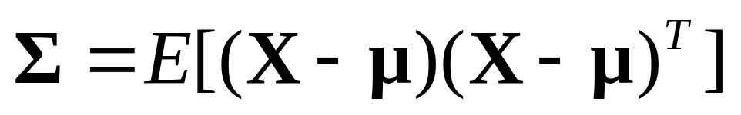
Random Vectors
A d-dimensional
random vector
Vector Mean:
Covariance Matrix:

Slide 36
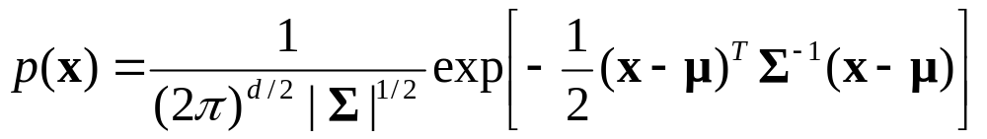

Multivariate Gaussian Distribution
X~N(μ,Σ)
A d-dimensional random vector
E[X] =μ
E[(X-μ) (X-μ)^{T}] =Σ

Slide 37
Properties of N(μ,Σ)
X~N(μ,Σ)
A d-dimensional random vector
Let Y=A^{T}X, where A is a d × k matrix.
Y~N(A^{T}μ, A^{T}ΣA)

Slide 38

Properties of N(μ,Σ)
X~N(μ,Σ)
A d-dimensional random vector
Let Y=A^{T}X, where A is a d × k matrix.
Y~N(A^{T}μ, A^{T}ΣA)

Slide 39




On Parameters of N(μ,Σ)
X~N(μ,Σ)

Slide 40



More On Covariance Matrix
∑ is symmetric and positive semidefinite.
Φ: orthonormal matrix, whose columns are eigenvectors of ∑.
Λ: diagonal matrix (eigenvalues).

Slide 41



Whitening Transform
X~N(μ,Σ)
Y=A^{T}X
Y~N(A^{T}μ, A^{T}ΣA)
Let

Slide 42
Whitening Transform
X~N(μ,Σ)
Whitening
Linear
Transform
Y=A^{T}X
Y~N(A^{T}μ, A^{T}ΣA)
Let
Projection

Slide 43

Mahalanobis Distance
X~N(μ,Σ)
r²
constant
depends on
the value of r²

Slide 44

Mahalanobis Distance
X~N(μ,Σ)
r²
constant
depends on
the value of r²

Slide 45
Bayesian Decision Theory
(Classification)
Discriminant Functions for the Normal Populations

Slide 46


Minimum-Error-Rate Classification
X_{i}~N(μ_{i},Σ_{i})

Slide 47



Minimum-Error-Rate Classification
Three Cases:
Case 1:
Classes are centered at different mean, and their feature components are pairwisely independent have the same variance.
Case 2:
Classes are centered at different mean, but have the same variation.
Case 3:
Arbitrary.

Slide 48




Case 1. ∑_{i} = σ²I
irrelevant
irrelevant

Slide 49



Case 1. ∑_{i} = σ²I

Slide 50







Case 1. ∑_{i} = σ²I
Boundary btw. ω_{i} and ω_{j}

Slide 51



The decision boundary will be a hyperplane perpendicular to the line btw. the means at somewhere.
Case 1. ∑_{i} = σ²I
x
x−x₀
w
0 if P(ω_{i})=P(ω_{j})
x₀
midpoint
Boundary btw. ω_{i} and ω_{j}
w^{T}

Slide 52



Case 1. ∑_{i} = σ²I
Minimum distance classifier (template matching)

Slide 53


Case 1. ∑_{i} = σ²I

Slide 54

Case 1. ∑_{i} = σ²I

Slide 55

Case 1. ∑_{i} = σ²I
Demo

Slide 56

Case 2. ∑_{i} = ∑
Mahalanobis
Distance
Irrelevant if
P(ω_{i})= P(ω_{j}) ∀i, j
irrelevant

Slide 57



Case 2. ∑_{i} = ∑
Irrelevant

Slide 58



Case 2. ∑_{i} = ∑
x
w
x₀

Slide 59

Case 2. ∑_{i} = ∑

Slide 60

Demo
Case 2. ∑_{i} = ∑

Slide 61





Case 3. ∑_{i} ≠ ∑ _{j}
Decision surfaces are hyperquadrics, e.g.,
hyperplanes
hyperspheres
hyperellipsoids
hyperhyperboloids
Without this term
In Case 1 and 2
irrelevant

Slide 62

Case 3. ∑_{i} ≠ ∑ _{j}
Non-simply connected decision regions can arise in one dimensions for Gaussians having unequal variance.

Slide 63


Case 3. ∑_{i} ≠ ∑ _{j}

Slide 64

Case 3. ∑_{i} ≠ ∑ _{j}

Slide 65

Case 3. ∑_{i} ≠ ∑ _{j}
Demo

Slide 66

Multi-Category Classification

Slide 67
Bayesian Decision Theory
(Classification)
Minimax Criterion

Slide 68
Bayesian Decision Rule:
Two-Category Classification
Threshold
Likelihood
Ratio
Decide α₁ if
Minimax criterion deals with the case that
the prior probabilities are unknown.

Slide 69
Basic Concept on Minimax
To choose the worst-case prior probabilities (the maximum loss) and, then, pick the decision rule that will minimize the overall risk.
Minimize the maximum possible overall risk.

Slide 70


Overall Risk

Slide 71

Overall Risk

Slide 72



Overall Risk

Slide 73


Overall Risk

Slide 74
R(x) = ax + b
Overall Risk
The value depends on
the setting of decision boundary
The value depends on
the setting of decision boundary
The overall risk for a particular P(ω₁).

Slide 75
R(x) = ax + b
Overall Risk
= 0 for minimax solution
= R_{mm}, minimax risk
Independent on the value of P(ω_{i}).

Slide 76


Minimax Risk

Slide 77

Use 0/1 loss function
Error Probability

Slide 78


Use 0/1 loss function
Minimax Error-Probability
P(α₁|ω₂)
P(α₂|ω₁)

Slide 79
Minimax Error-Probability
P(α₁|ω₂)
P(α₂|ω₁)
ω₁
ω₂
R₁
R₂

Slide 80

Minimax Error-Probability

Slide 81
Bayesian Decision Theory
(Classification)
Neyman-Pearson Criterion

Slide 82
Bayesian Decision Rule:
Two-Category Classification
Threshold
Likelihood
Ratio
Decide α₁ if
Neyman-Pearson Criterion deals with the case that both loss functions and the prior probabilities are unknown.

Slide 83

Signal Detection Theory
The theory of signal detection theory evolved from the development of communications and radar equipment the first half of the last century.
It migrated to psychology, initially as part of sensation and perception, in the 50's and 60's as an attempt to understand some of the features of human behavior when detecting very faint stimuli that were not being explained by traditional theories of thresholds.

Slide 84
The situation of interest
A person is faced with a stimulus (signal) that is very faint or confusing.
The person must make a decision, is the signal there or not.
What makes this situation confusing and difficult is the presences of other mess that is similar to the signal. Let us call this mess noise.

Slide 85

Example
Noise is present both in the environment and in the sensory system of the observer.
The observer reacts to the momentary total activation of the sensory system, which fluctuates from moment to moment, as well as responding to environmental stimuli, which may include a signal.

Slide 86
Example
A radiologist is examining a CT scan, looking for evidence of a tumor.
A hard job, because there is always some uncertainty.
There are four possible outcomes:
  hit (tumor present and doctor says "yes'')
  miss (tumor present and doctor says "no'')
  false alarm (tumor absent and doctor says "yes")
  correct rejection (tumor absent and doctor says "no").
Two types
of Error

Slide 87
Signal detection theory was developed to help us understand how a continuous and ambiguous signal can lead to a binary yes/no decision.
The Four Cases
Signal (tumor)
Absent (ω₁)
Present (ω₂)
Correct Rejection
Miss
P(α₁|ω₁)
P(α₁|ω₂)
No (α₁)
Decision
False Alarms
Hit
P(α₂|ω₁)
P(α₂|ω₂)
Yes (α₂)

Slide 88


Discriminability
Decision Making
Criterion
Based on expectancy
(decision bias)
d’
Noise
Noise + Signal
Hit
P(α₂|ω₂)
False
Alarm
P(α₂|ω₁)
μ₁
μ₂
No (α₁)
Yes (α₂)

Slide 89

ROC Curve
(Receiver Operating Characteristic)
Hit
P_{H}=P(α₂|ω₂)
False
Alarm
P_{FA}=P(α₂|ω₁)

Slide 90
Neyman-Pearson Criterion
Hit
P_{H}=P(α₂|ω₂)
NP:
max. P_{H}
subject to P_{FA} ≦ a
False
Alarm
P_{FA}=P(α₂|ω₁)

Slide 91



Likelihood Ratio Test
where T is a threshold that meets the P_{FA} constraint (≦ a).
How to determine T?

Slide 92







Likelihood Ratio Test
P_{H}
P_{FA}
R₁
R₂

Slide 93



Neyman-Pearson Lemma
Consider the aforementioned rule with T chosen to give P_{FA}(α) =a. There is no decision rule α’ such that P_{FA}(α’) ≤ a and P_{H}(α’) > P_{H}(α) .
Pf)
Let α’ be a decision rule with
> 0
=1
≥ 0

Slide 94

Neyman-Pearson Lemma
Consider the aforementioned rule with T chosen to give P_{FA}(α) =a. There is no decision rule α’ such that P_{FA}(α’) ≦a and P_{H}(α’) > P_{H}(α) .
Pf)
Let α’ be a decision rule with
≤0
√
=0
≤0

Slide 95


Neyman-Pearson Lemma
OK
Consider the aforementioned rule with T chosen to give P_{FA}(α) =a. There is no decision rule α’ such that P_{FA}(α’) ≦a and P_{H}(α’) > P_{H}(α) .
Pf)
Let α’ be a decision rule with
≥0

